Slide 1
Отчет о работе ВО «Правильный Выбор» и Центра Карьеры за год 22-23г
Here is where your presentation begins

Slide 2
25.10.22 Экскурсия в анатомический музей для учеников школы №9; Экскурсия в музей анатомии для учеников школы №42, 11 класс 21.10 Экскурсия в анатомический музей для учеников 10а класса школы №3 11.11 Экскурсия в анатомический музей для учеников 10б класса школы №3 18.11 Экскурсия в анатомический музей для учеников 9в класса школы №3 25.11 Экскурсия в анатомический музей для учеников 11 класса школы №3
“This is a quote, words full of wisdom that someone important said and can make the reader get inspired.”

Slide 3
9.12 экскурссия в ЧГМА и музей анатомии для школы № 3 15.12 экскурсия в ЧГМА и музей анатомии для школы № 2
“This is a quote, words full of wisdom that someone important said and can make the reader get inspired.”

Slide 4
1.03 Профориентационная экскурсия в ЧГМА, музей анатомии и мастер-класс по первой помощи совместно с ВО «Феникс» для учеников 21 гимназии.
“This is a quote, words full of wisdom that someone important said and can make the reader get inspired.”

Slide 5
02
1.03 Флешмоб
You can enter a subtitle here if you need it

Slide 6
3.03 Профориентационная экскурсия в ЧГМА и музей анатомии для учеников из пгт. Агинское

Slide 7
01
15.02 2 лекции на тему «Влияние вейпов на организм подростков» в школе № 33
You can enter a subtitle here if you need it

Slide 8
17.03 2 лекции на тему « Вред курения вейпов для здоровья человека» в школе № 48
Big numbers catch your audience’s attention

Slide 9
14. 04 Лекция на тему «Вред вейпов» в гимназии №12 14. 04 Экскурсия в ЧГМА и музей анатомии для гимназии № 12 7.04 Экскурсия в ЧГМА и музей анатомии для гимназии№12 05.05 Экскурсия в ЧГМА и музей анатомии для гимназии № 12 12.05 Экскурсия в музей анатомии для гимназии №12 19.05 Экскурсия в музей анатомии для учеников из пгт. Дарасун Участие в дне открытых дверей
“This is a quote, words full of wisdom that someone important said and can make the reader get inspired.”

Slide 10
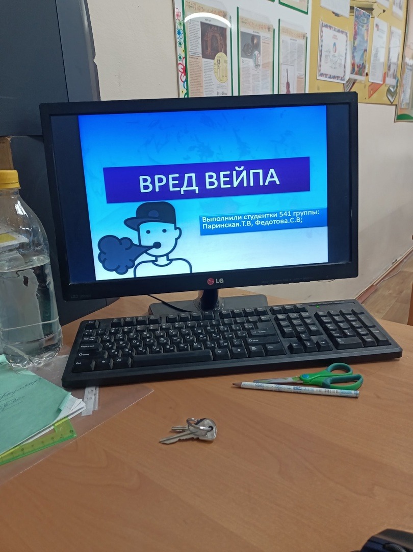
Contents of this template
This is a slide structure based on a multi-purpose presentation
You can delete this slide when you’re done editing the presentation
Fonts | To view this template correctly in PowerPoint, download and install the fonts we used
Used and alternative resources | An assortment of graphic resources that are suitable for use in this presentation
Thanks slide | You must keep it so that proper credits for our design are given
Colors | All the colors used in this presentation
Icons and infographic resources | These can be used in the template, and their size and color can be edited
Editable presentation theme | You can edit the master slides easily. For more info, click here
For more info: SLIDESGO | SLIDESGO SCHOOL | FAQs
You can visit our sister projects: FREEPIK | FLATICON | STORYSET | WEPIK | VIDEVO

Slide 11
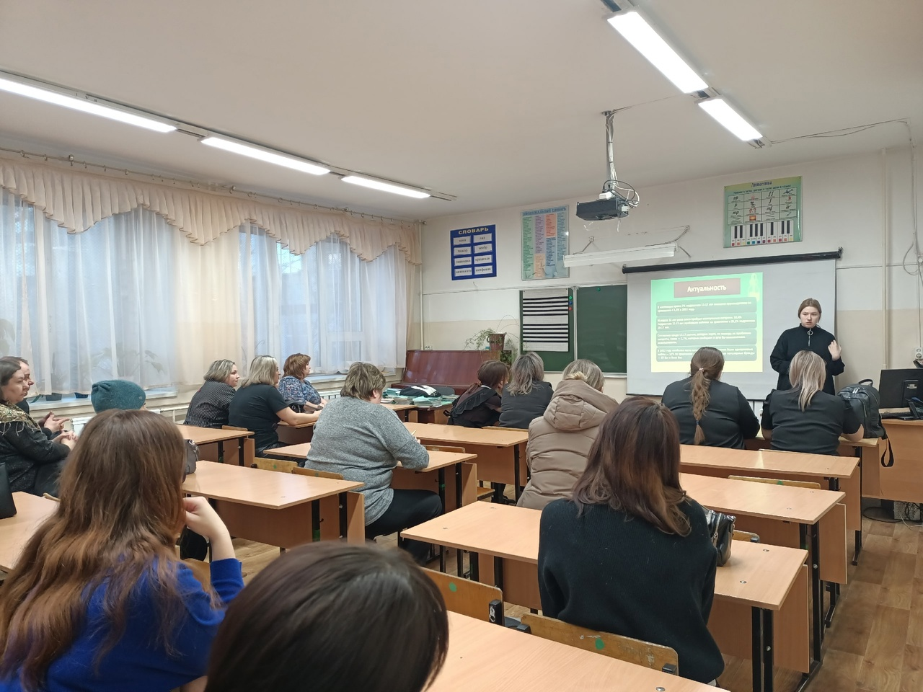
Table of contents
01
02
Our university
History
03
04
Save the date
Celebration
You can describe the topic of the section here
You can describe the topic of the section here
You can describe the topic of the section here
You can describe the topic of the section here

Slide 12
Центр Карьеры

Slide 13
16.02 первое собрание актива Центра Карьеры
You can replace the image. Just right-click on it and select “Replace image”

Slide 14
03
15.03 Интервью с начальником отдела кадровой политики МЗ Забайкальского края Лазаревой Еленой Владимировны
You can enter a subtitle here if you need it

Slide 15
16.03 Интервью с Главным врачом ГКБ №1 Чепцовым Федором Романовичем

Slide 16
04
16.03 Организация встречи ординаторов и студентов 6 курса с заместителем главного врача ГКБ №1 по хирургии Лобановым Леонидом Сергеевичем
You can enter a subtitle here if you need it

Slide 17
01
16.03 Интервью с заместителем главного врача ГКБ № 1 по хирургии Лобановым Леонидом Сергеевичем
You can enter a subtitle here if you need it

Slide 18
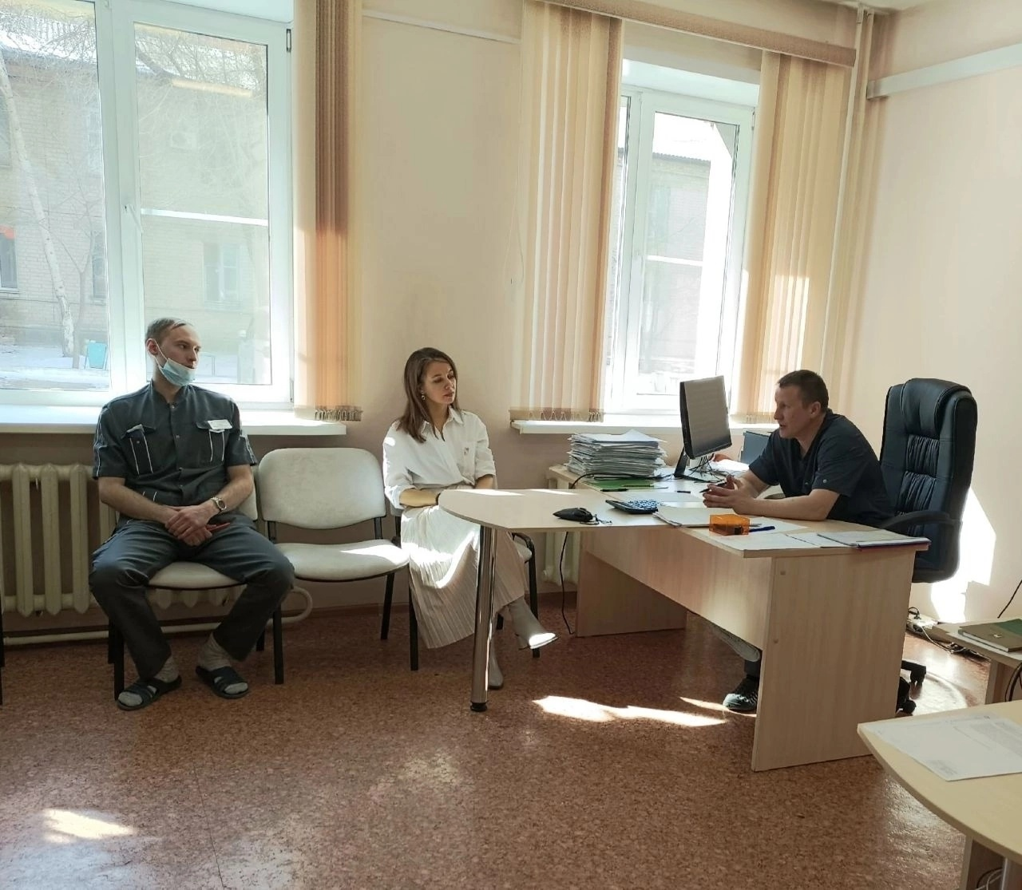
Our best assignment
Mars
Venus
Despite being red, Mars is a cold place
Venus has extremely high temperatures
Jupiter
Saturn
It’s the biggest planet in the Solar System
Saturn is a gas giant and has several rings

Slide 19
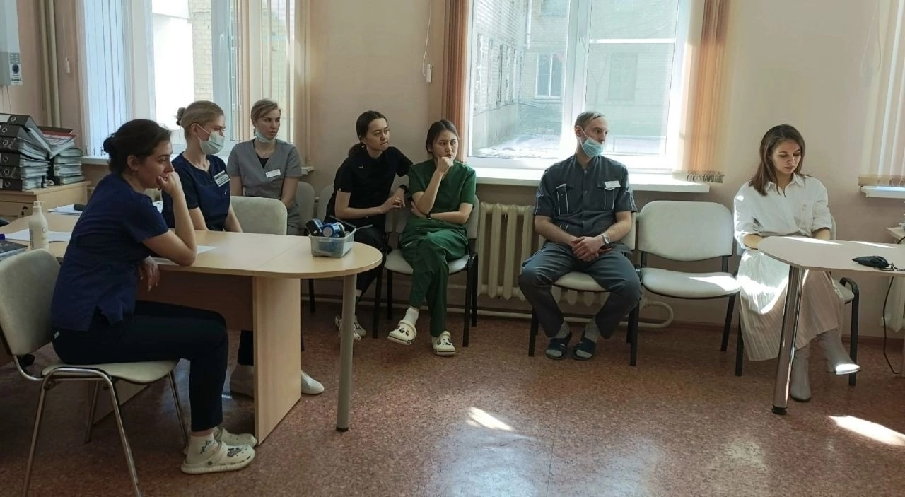
History of our university
Mercury is the closest planet to the Sun and the smallest one in the entire Solar System. This planet's name has nothing to do with the liquid metal, since Mercury was named after the Roman messenger god. Despite being closer to the Sun than Venus, its temperatures aren't as terribly hot as that planet's. Its surface is quite similar to that of Earth's Moon, which means there are a lot of craters and plains
Speaking of craters, many of them were named after artists or authors who made significant contributions to their respective fields. Mercury takes a little more than 58 days to complete its rotation, so try to imagine how long days must be there! Since the temperatures are so extreme, albeit not as extreme as in Venus, and the solar radiation is so high, Mercury has been deemed to be non-habitable for humans

Slide 20
16.03 интервью с ординатором по специальности «Терапия» Еленой Придатко
Do you know what helps you make your point clear? Lists like this one:
They’re simple
You can organize your ideas clearly
You’ll never forget to buy milk!
And the most important thing: the audience won’t miss the point of your presentation

Slide 21
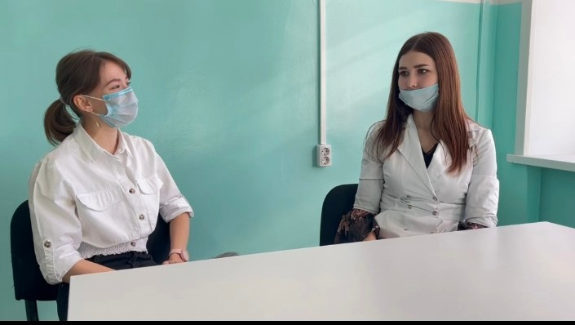
Who is graduating?
Mercury
Venus
Mercury is the closest planet to the Sun and the smallest one in the Solar System—it’s only a bit larger than the Moon
Venus has a beautiful name and is the second planet from the Sun. It’s hot and has a poisonous atmosphere

Slide 22
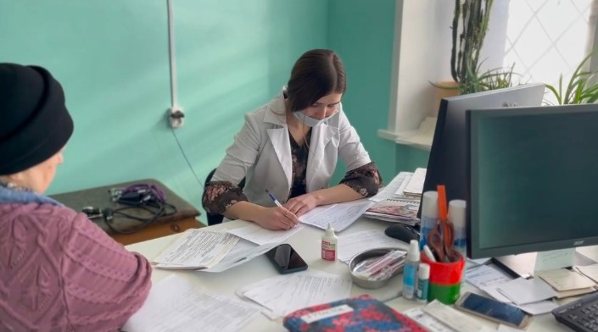
Awards
Mercury
Venus
Mars
It’s the closest planet to the Sun and the smallest one in the Solar System
Venus has a beautiful name and is the second planet from the Sun
Despite being red, Mars is actually a cold place. It’s full of iron oxide dust

Slide 23
24.03 Интервью с ординатором 2 года по специальности «Травматология-Ортопедия» Каплиной Маргаритой Николаевной
This can be the part of the presentation where you introduce yourself, write your email…

Slide 24
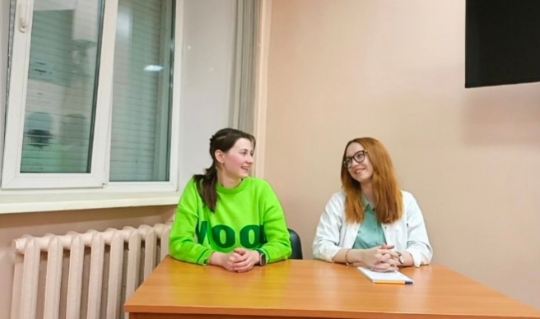
Special honors
Mars
Venus
Neptune
Despite being red, Mars is a cold place
Venus has extremely high temperatures
Neptune is the farthest planet from the Sun
Mercury
Saturn
Jupiter
Mercury is the closest planet to the Sun
Saturn is a gas giant with several rings
Jupiter is the biggest planet of them all

Slide 25
03
24.03 Интервью с ординатором 2 года по специальности «Неонатология» Гладких Екатериной Сергеевной
You can enter a subtitle here if you need it

Slide 26
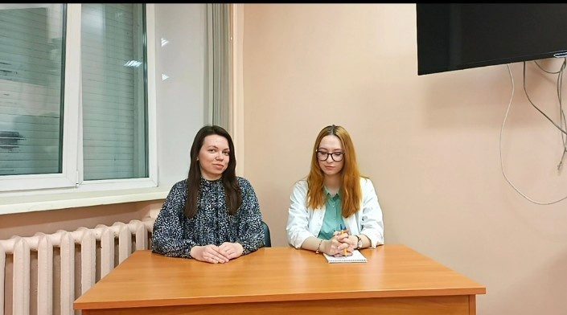
9h 55m 23s
333,000
386,000 km
Jupiter's rotation period
The Sun’s mass compared to Earth’s
Distance between Earth and the Moon

Slide 27
20 и 27. 03 Информационные посты о заключении целевого договора
Do you know what helps you make your point clear? Lists like this one:
They’re simple
You can organize your ideas clearly
You’ll never forget to buy milk!
And the most important thing: the audience won’t miss the point of your presentation

Slide 28
Favorite subjects
25%
50%
75%
Mercury
Venus
Mars
It’s the closest planet to the Sun and the smallest one in the Solar System
Venus has a beautiful name and is the second planet from the Sun
Despite being red, Mars is actually a cold place. It’s full of iron oxide dust

Slide 29
03
14.03 Опрос, связанный с мотивацией студентов и ординаторов ЧГМА работать по специальности.
You can enter a subtitle here if you need it

Slide 30
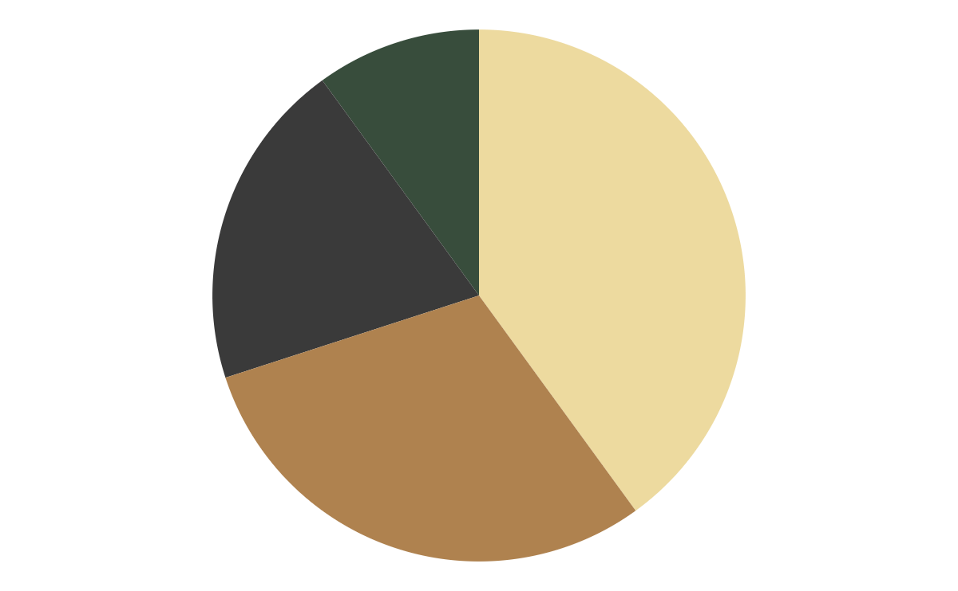
Favorite courses
10%
40%
Mercury
Venus
20%
30%
Jupiter
Saturn
It’s the closest planet to the Sun
Venus has very high temperatures
It’s the biggest planet of them all
Saturn is a gas giant with rings
Follow the link in the graph to modify its data and then paste the new one here. For more info, click here

Slide 31
01
17.03 Съемка навигационных роликов в МЗ Забайкальского края и ГКБ № 1
You can enter a subtitle here if you need it

Slide 32
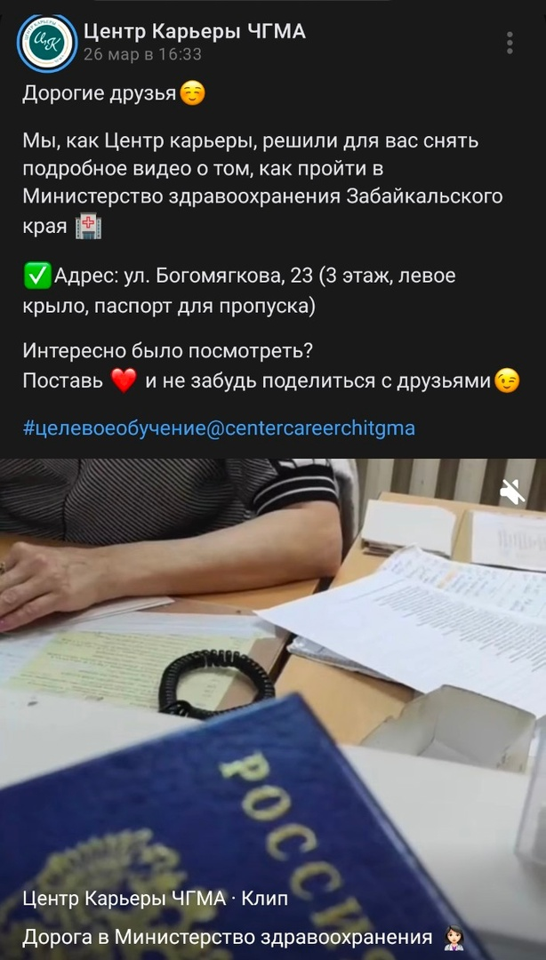
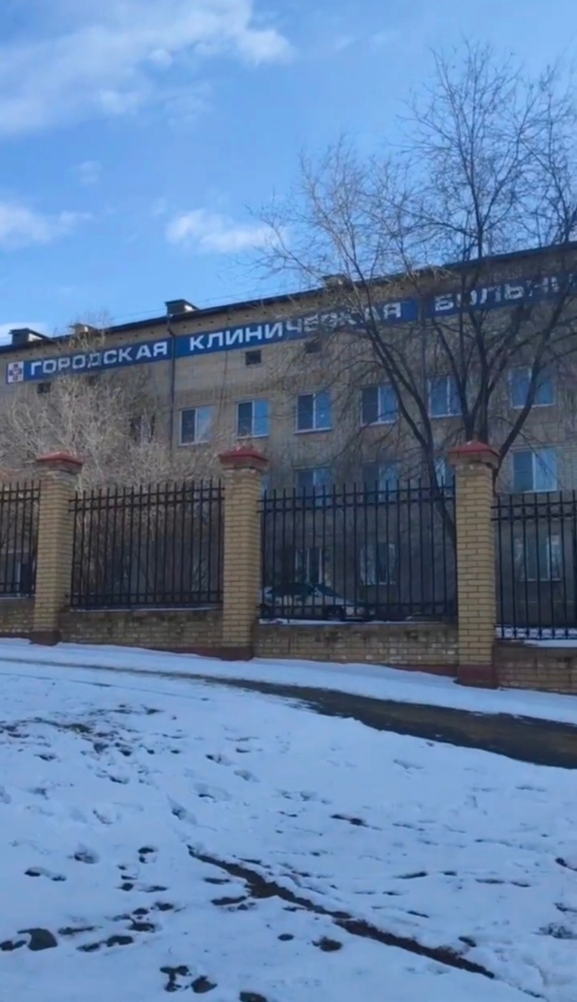
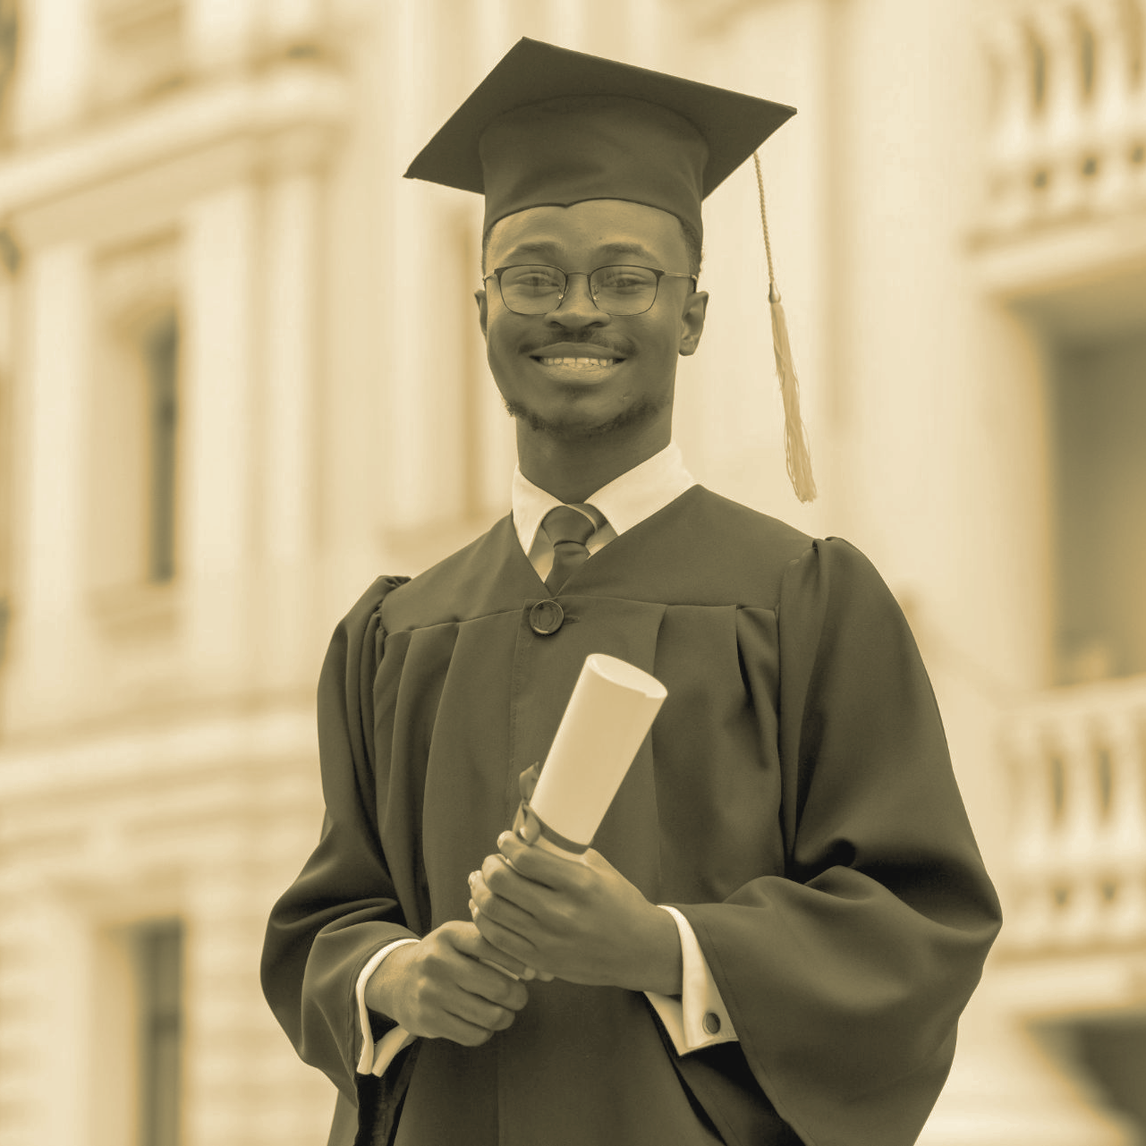
The best students
Anna Jones
Harry Roberts
Elsie Evans
You can speak a bit about this person here
You can speak a bit about this person here
You can speak a bit about this person here

Slide 33
03
5. 04. встреча с начальником юридического отдела Ивановой Валерией Григорьевной ЧГМА "юридическая сторона целевого договора«; 21.04 встреча с юристом ГКБ1 "Юридическая защита врача»
You can enter a subtitle here if you need it

Slide 34
01
24.04 Ярмарка Вакансий
You can enter a subtitle here if you need it

Slide 35
01
12.05 ВСТРЕЧА на кафедре патологической анатомии для студентов 5-6 курсов; 16.05 встреча с врачами неонатолагами для студентов 5-6 курсов Паспорта специальности: неврология, травматология, неврология, озис и т.д.
You can enter a subtitle here if you need it

Slide 36
01
Ежедневные информационные посты для абитуриентов, студентов и ординаторов.
You can enter a subtitle here if you need it

Slide 37
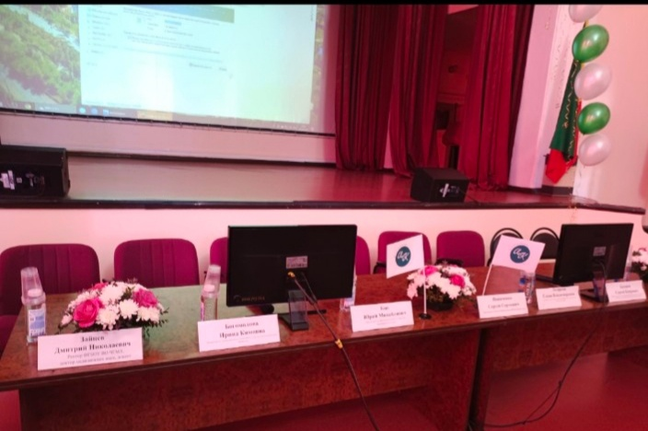
01
Ежедневные информационные посты для абитуриентов, студентов и ординаторов.
You can enter a subtitle here if you need it

Slide 38
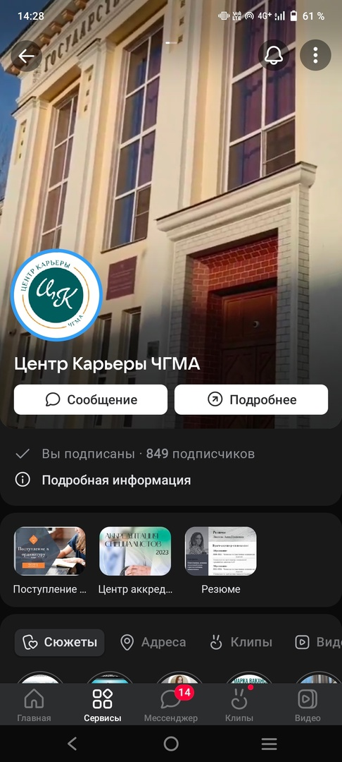
01
You can enter a subtitle here if you need it

Slide 39
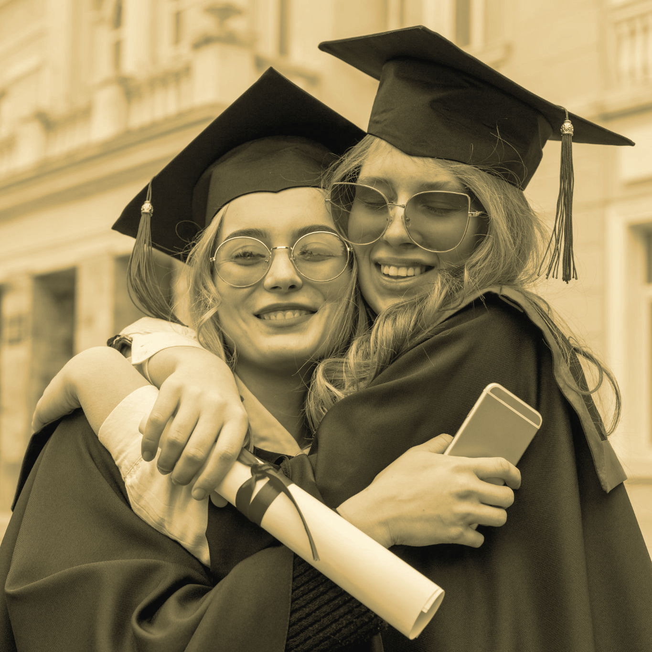
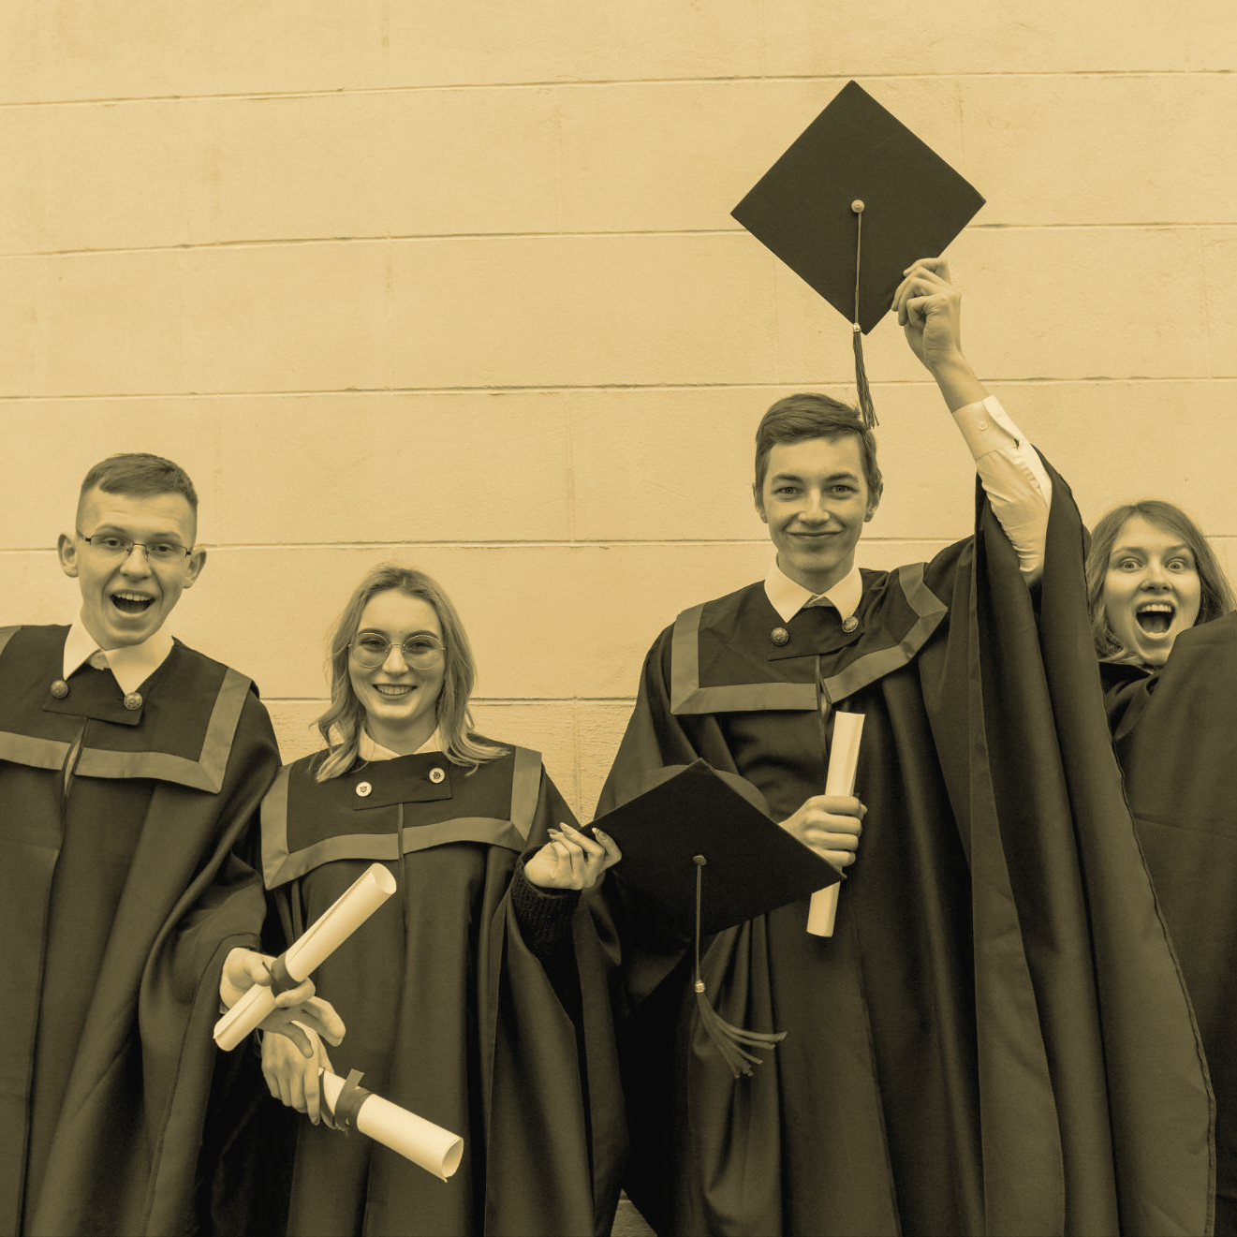
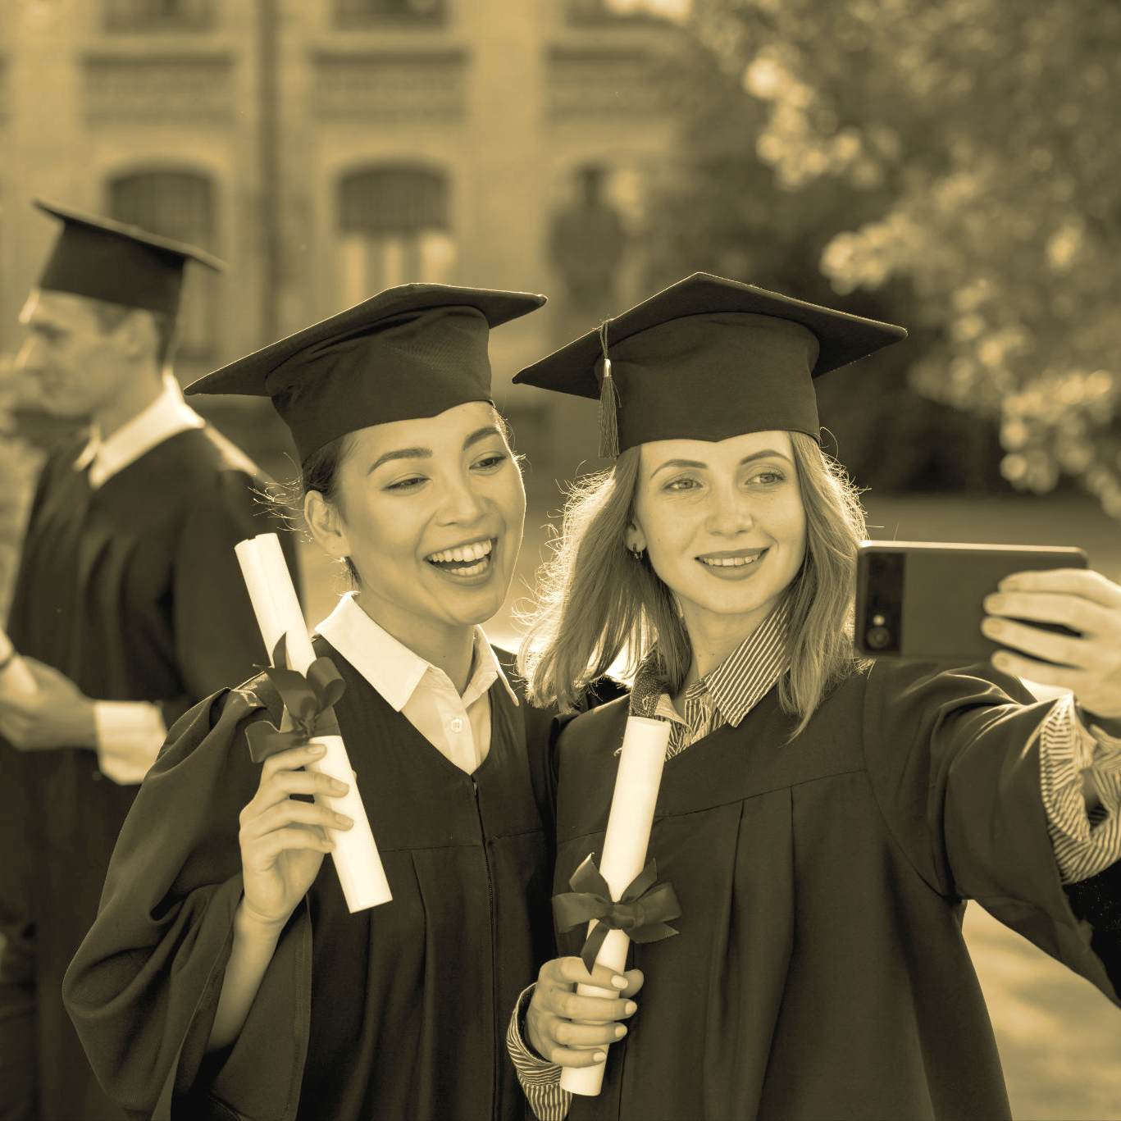
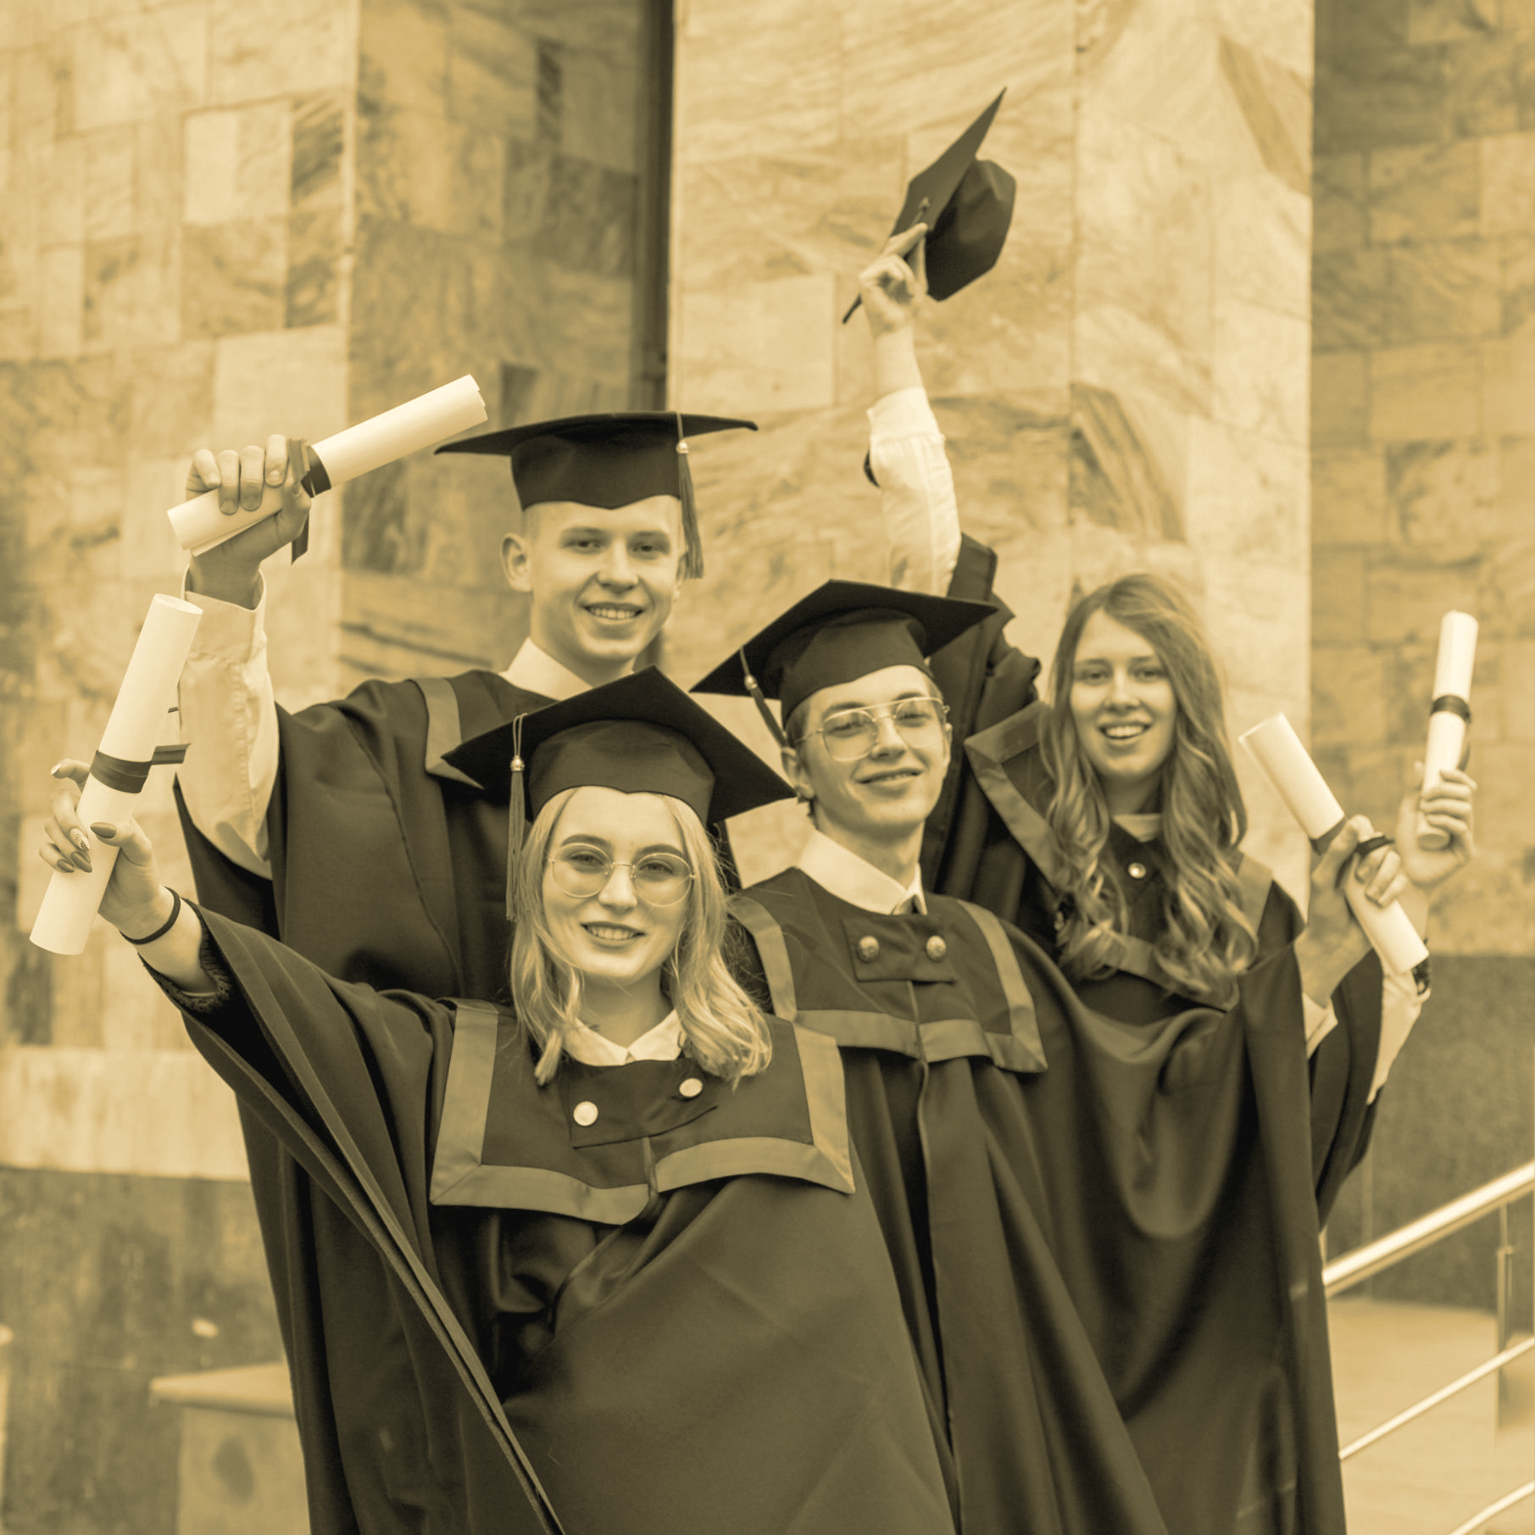
Спасибо за внимание!

